Slide 1
Final Presentation
Zhiyi Sun

Slide 2
Research Topic:
Global Suicide Rates Analysis & Prediction for Suicide Prevention

Slide 3
Global Suicide Rates Analysis & Prediction for Suicide Prevention
Data
Research Sub-questions
Exploratory Data Analysis
Correlations
Hypothesis Tests
Models & Prediction
Conclusion

Slide 4
Data
The dataset was referenced from Kaggle https://www.kaggle.com/russellyates88/suicide-rates-overview-1985-to-2016
This compiled dataset pulled from four other datasets linked by time and place, and was built to find signals correlated to increased suicide rates among different cohorts globally, across the socio-economic spectrum.

Slide 5
Dataset Features List
country: country name
year: year of data
sex: sex of suicide victim
age: age range of suicide victim
suicides_no: number of suicides
population: population of country
suicides/100k pop: suicides per 100k of population
country-year: country in certain year
HDI for year: Human Development Index (HDI) for that year
gdp_for_year ($): Gross Domestic Product for that year
gdp_per_capita ($): Gross Domestic Product per person
generation: people born between certain years

Slide 6
Research Sub-questions
Global suicide rates trend
Over Correlation & Correlations between particular variables
Hypothesis tests to check if there is a link between suicide rates and particular variables
Models' selection & prediction

Slide 7
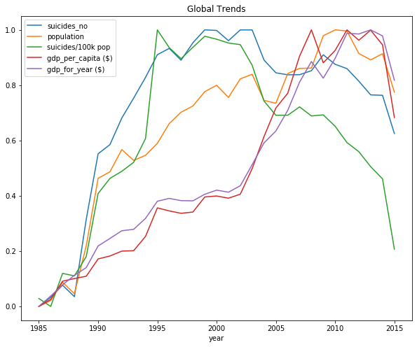
Exploratory Data Analysis

Slide 8
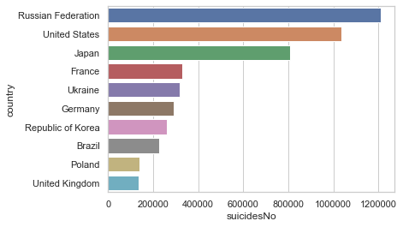
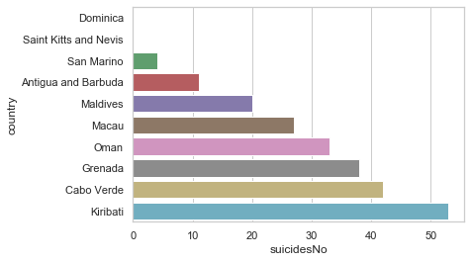
Top 10 countries with most & least number of suicide
Russian Federation has the most suicide cases.

Slide 9
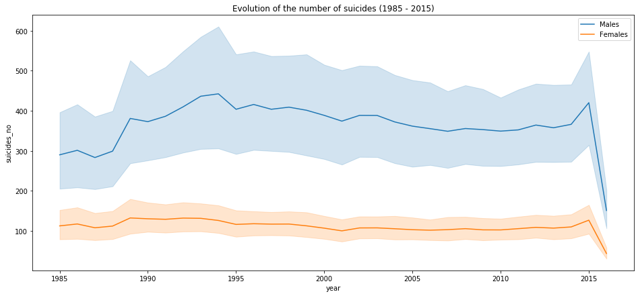
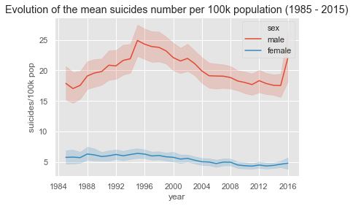
Suicides in Male & Female
Men tend to be more suicidal than women.

Slide 10
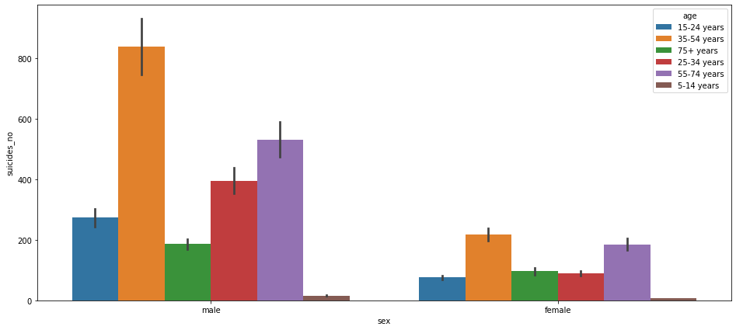
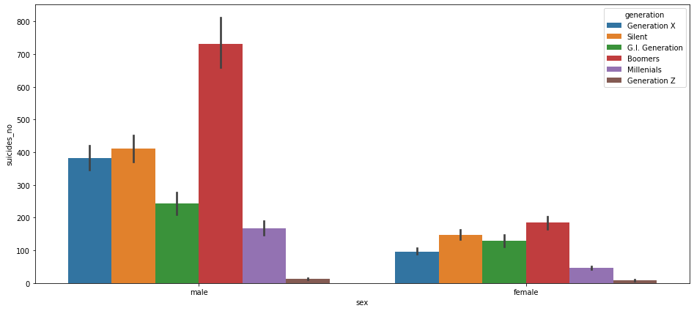
Suicides across Age & Generation
The people at age of 35-54 years and in Boomers generation suicide most.

Slide 11
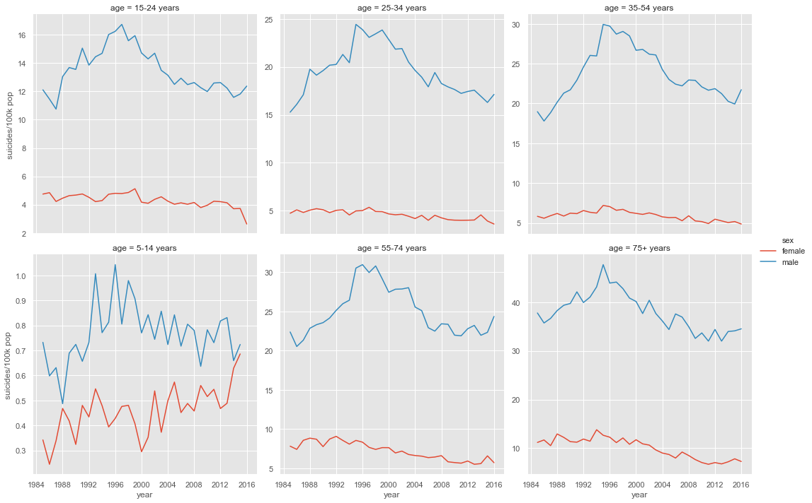
Evolution of suicide by sex and age category (1985 - 2015)

Slide 12
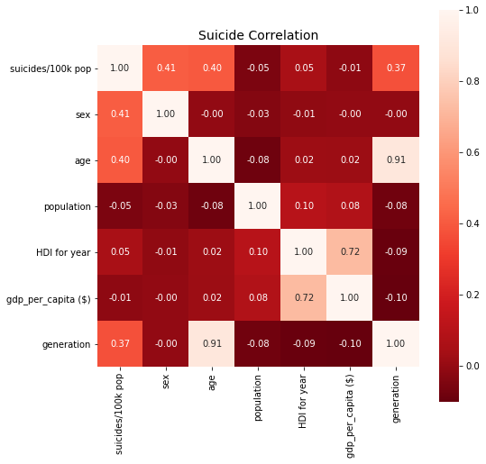
Correlations
Overall Correlation
Age, generation and sex are significant factors in determining suicide rates.

Slide 13
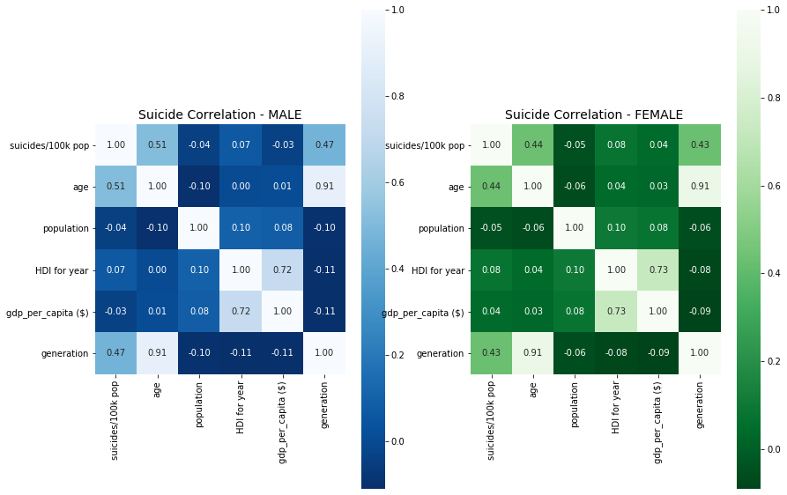
Overall Correlation – Male & Female
Age, generation and sex are significant factors in determining suicide rates for both males and females.

Slide 14
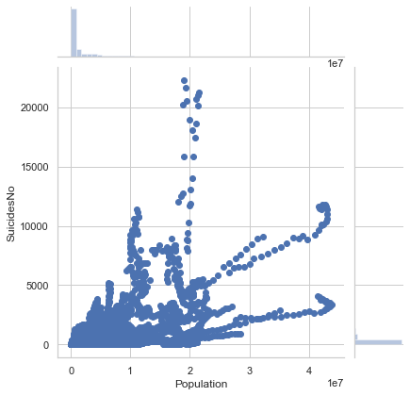
Correlation between the number of suicide and population
More population doesn‘t mean more people suicide.

Slide 15
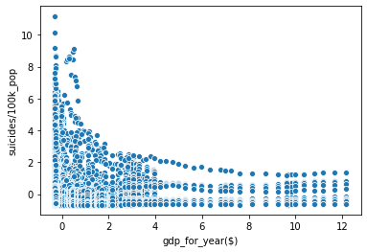
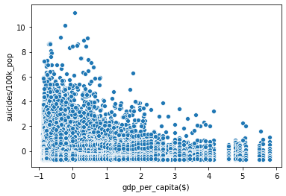
Correlations between suicide rates and GDP & GDP per capita
When GDP is low, it seems that there will be more suicides per 100,000 population.

Slide 16
Hypothesis Tests
Hypothesis 1: (Two-Sample t-Test)
H0: There is no difference in the suicide rates between male and female
Ha: There is a difference in the suicide rates between male and female
# calculating p value
ttest,pval = stats.ttest_rel(male, female)
if pval<0.05:
print("Reject null hypothesis")
else:
print("Accept null hypothesis")
Reject null hypothesis
There is sufficient evidence to Reject H0, and conclude that there is significant difference in the suicide rates between male and female.

Slide 17
Hypothesis Tests
Hypothesis 2: (Chi-squared Test)
H0: Suicide rates and age are independent
Ha: Suicide rates and age are dependent
Significance level: 0.05
Degree of Freedom: 26485
chi-square statistic: 39571.48433519147
critical_value: 26864.700169422224
p-value: 0.0
There is sufficient evidence to Reject H0, and conclude that there is significant difference in the suicide rates between different age groups.

Slide 18
Hypothesis Tests
Hypothesis 3: (Chi-squared Test)
H0: There is no correlation between suicide rates and generation
Ha: There is a correlation between suicide rates and generation
Significance level: 0.05
Degree of Freedom: 26485
chi-square statistic: 31584.46289376714
critical_value: 26864.700169422224
p-value: 4.174669995610524e-97
There is sufficient evidence to Reject H0, and conclude that there is a correlation between suicide rates and generation.

Slide 19
Hypothesis Tests
Hypothesis 4: (Kruskal-Wallis Test)
H0: The suicide rates of teenagers in 1990 is not significantly different than suicide rates of teenagers in 2010
Ha: The suicide rates of teenagers in 1990 is significantly different than suicide rates of teenagers in 2010
KruskalResult(statistic=2.4683136176426177, pvalue=0.11616249680017487)
There is NO sufficient evidence to Reject H0, and hence we conclude that the suicide rates of teenagers in 1990 is not significantly different than suicide rates of teenagers in 2010.

Slide 20
Hypothesis Tests
Hypothesis 5: (Pearson correlation coefficient)
H0: There is no correlation between suicide rates of 2015 and GDP or GDP per capita
Ha: There is a correlation between suicide rates of 2015 and GDP or GDP per capita
The correlation coefficient between suicide rate and GDP is (0.11474669571988942, 0.37450461034847354)
The correlation coefficient between suicide rate and GDP per capita is (0.12924333518234832, 0.3167497694689751)
From the coefficient, there appears to be a positive relationship between suicide rates and GDP or GDP per capita. However, by p-value, there is NO sufficient evidence to Reject H0, hence we conclude there is no correlation between suicide rates of 2015 and GDP or GDP per capita.

Slide 21
Models & Prediction
Splitting Data (80% for Training & 20% for Testing)
Models Training
Testing
Comparison of Models (Accuracy & RMSE)
Prediction
Supervised Machine Learning Models (regression)
Linear Regression
k-Nearest Neighbors Regression
Decision Tree
Random Forest
XGBoost
Multilayer Perceptrons

Slide 22
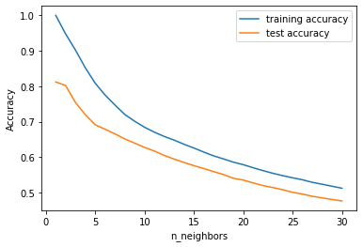
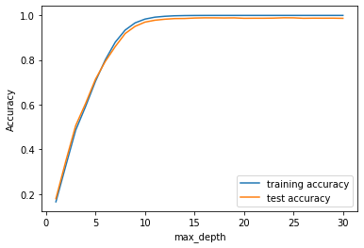
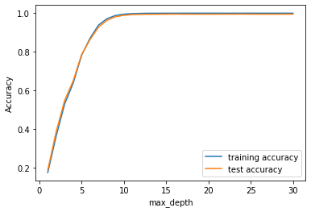
Y = suicide_rate
X = country + year + gender + age_group + suicide_count + population + gdp_for_year + gdp_per_capita + generation
KNN Regression
Decision Tree
Random Forest

Slide 23
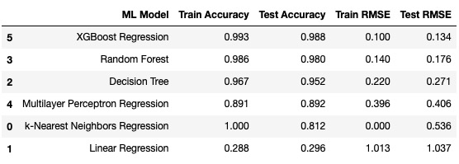
We can find KNN has the highest Train Accuracy and smallest Train RMSE. However, XGBoost gives us the highest Test Accuracy and smallest Test RMSE. Thus, the XGBoost model would be prefer.

Slide 24
Conclusion
The overall global suicide rates has increased from 1985 to 2015, but it is indeed decreasing now.
Men tend to be more suicidal than women.
The people at age of 35-54 years and in Boomers generation suicide most.
Age, generation and sex are significant factors in determining suicide rates.
More population doesn‘t mean more people suicide.
The XGBoost model is the best one to fit the suicide rates for prediction and it may be useful for future suicide prevention.
The suicide rates of teenagers in 1990 is not significantly different than suicide rates of teenagers in 2010.
A country with a low GDP or GDP per capita appears to have a higher suicide rate. However, in 2015, there is no correlation between suicide rates and GDP or GDP per capita.

Slide 25
References
United Nations Development Program. (2018). Human development index (HDI). Retrieved from http://hdr.undp.org/en/indicators/137506
World Bank. (2018). World development indicators: GDP (current US$) by country:1985 to 2016. Retrieved from http://databank.worldbank.org/data/source/world-development-indicators#
World Health Organization. (2018). Suicide prevention. Retrieved from http://www.who.int/mental_health/suicide-prevention/en/
Cohen, Jacob. (1986). Statistical Approaches to Suicidal Risk Factor Analysis. Annals of the New York Academy of Sciences. 487. 34-41. 10.1111/j.1749-6632.1986.tb27883.x.
Yao, Zizhen & Ruzzo, Walter. (2006). A Regression-based K nearest neighbor algorithm for gene function prediction from heterogeneous data. BMC bioinformatics. 7 Suppl 1. S11. 10.1186/1471-2105-7-S1-S11.
Biau, Gérard & Scornet, Erwan. (2015). A Random Forest Guided Tour. TEST. 25. 10.1007/s11749-016-0481-7.
Myles, Anthony & Feudale, Robert & Liu, Yang & Woody, Nathaniel & Brown, Steven. (2004). An Introduction to Decision Tree Modeling. Journal of Chemometrics. 18. 275 - 285. 10.1002/cem.873.
Trenn, S. (2008). Multilayer perceptrons: Approximation order and necessary number of hidden units. IEEE transactions on neural networks, 19(5), 836-844.
Chen, Tianqi & Guestrin, Carlos. (2016). XGBoost: A Scalable Tree Boosting System. 785-794. 10.1145/2939672.2939785.

Slide 26

Thank You!

